Slide 1
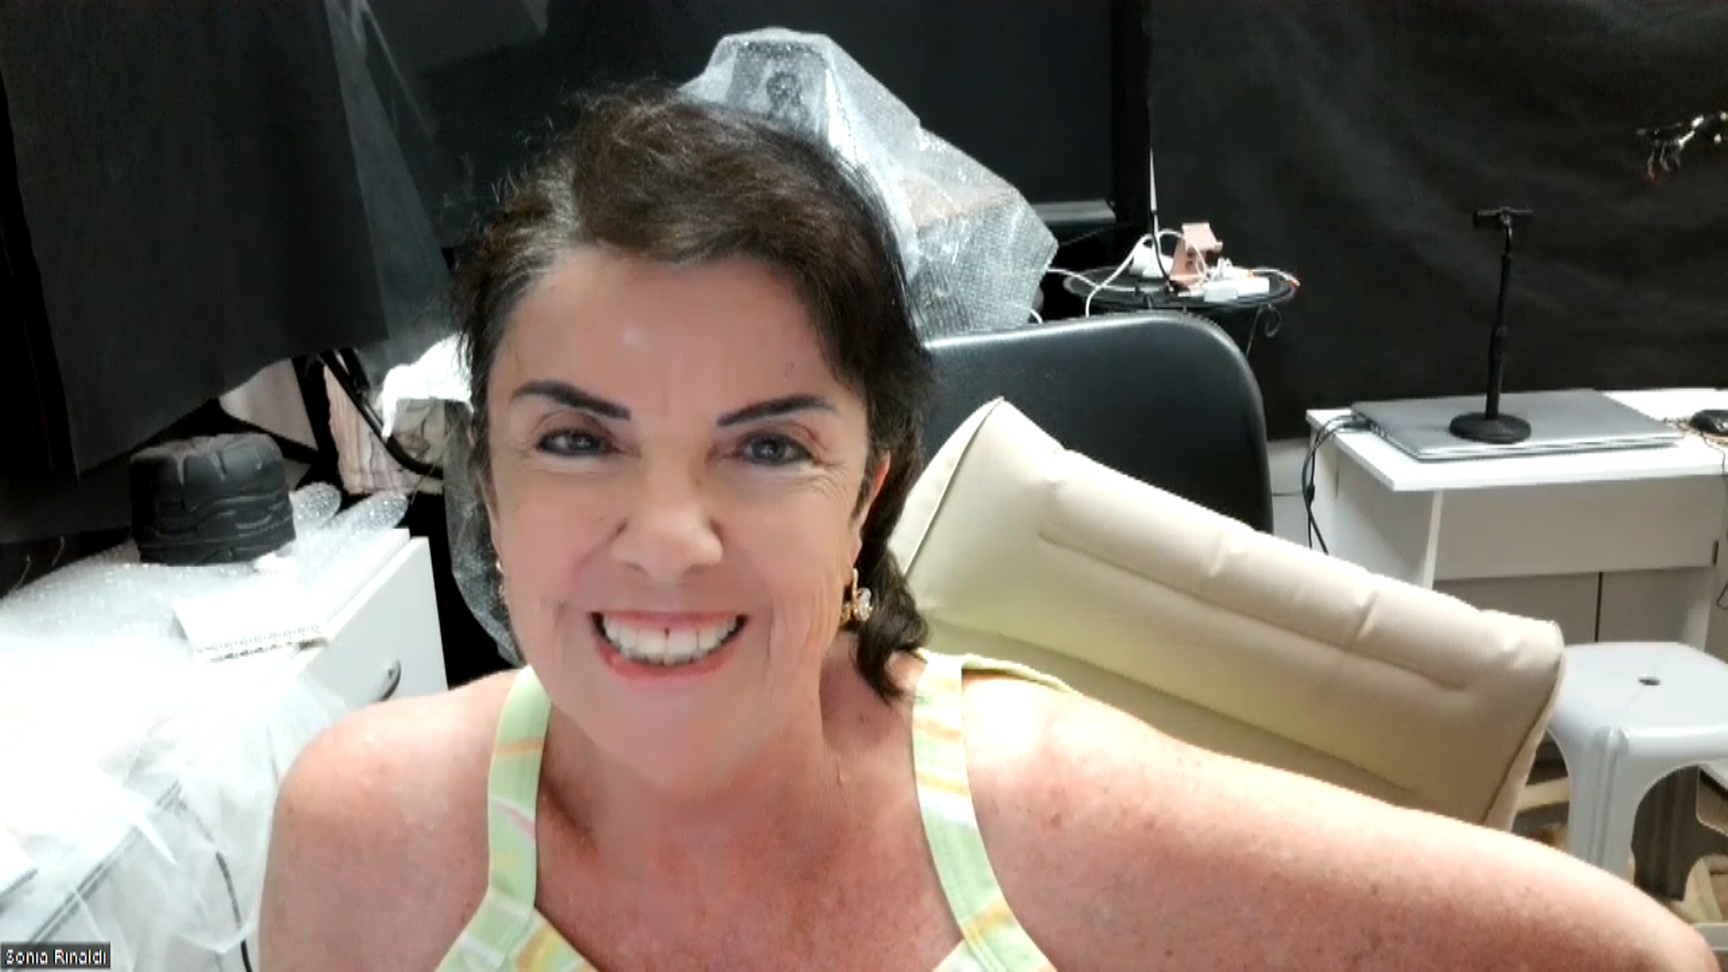
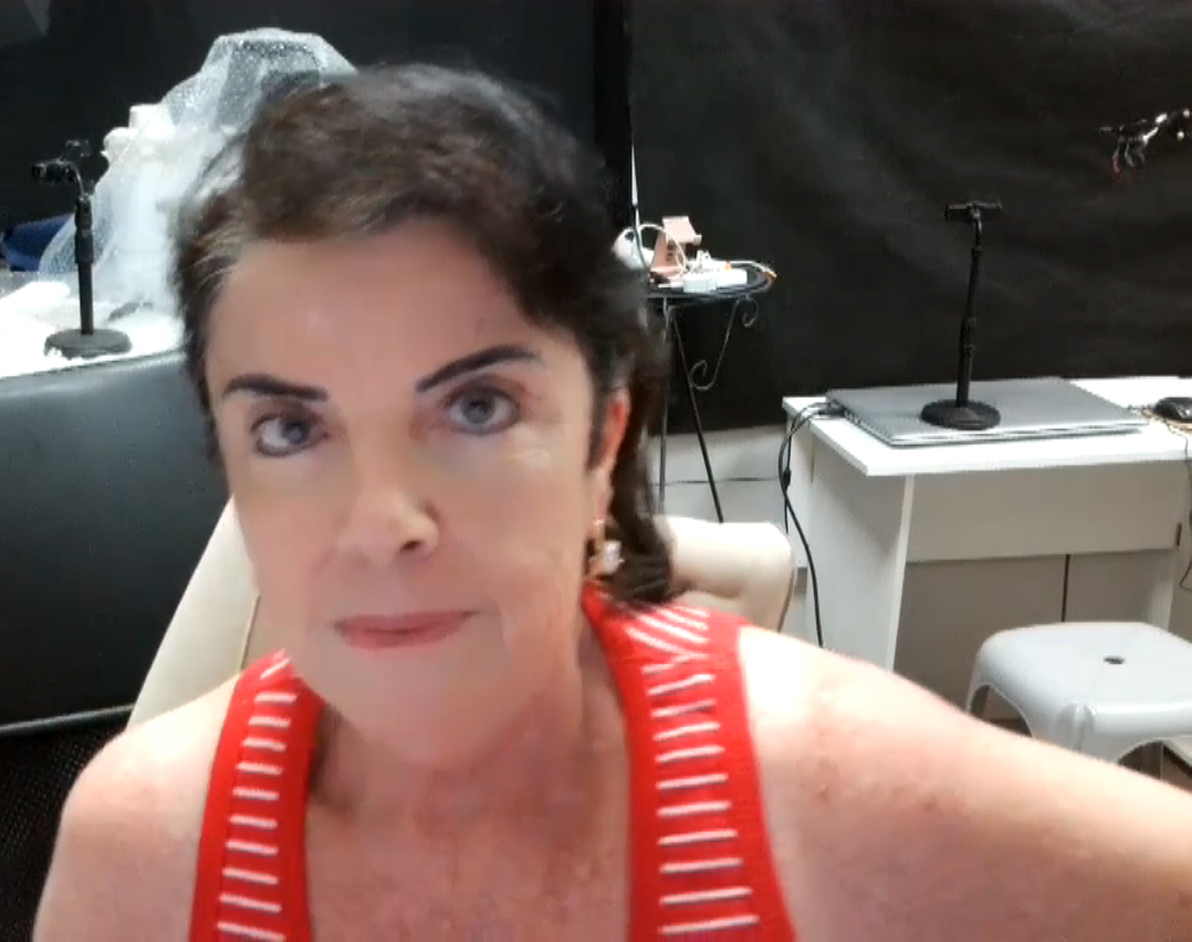
2003

Slide 2
Case 1

Slide 3

Mom introduces Alex
“I honestly can't tell you how absolutely overjoyed I am to receive these images! I've been laughing and crying at the same time but this time happy tears!
Please pass on my heartfelt thanks to Sonia for me for the work she has put into making these images.”
NTRODUCTION:
Gosh, so difficult to summarize his personality without writing an essay!
I would describe him as being very sensitive, thoughtful and caring.
If Alex was your friend, you would know about it as he would be your "ride or die" friend. He was fiercely protective of those he loved. He spent so much time helping his friends, especially if they were going through hard times themselves.
Alex Turner of Lancashire, England, passed from suicide on December 6, 2019 at age 24. His funeral was on Christmas Eve that year.

Slide 4

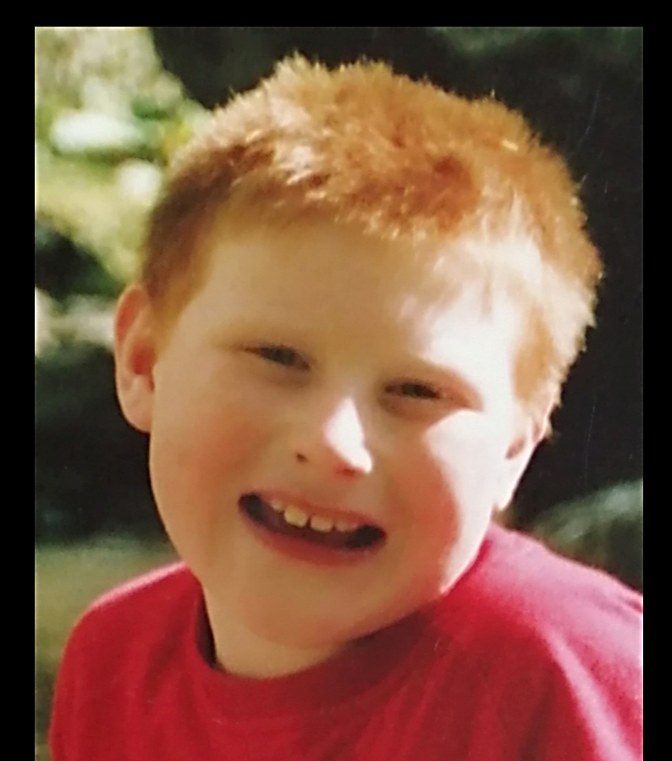
Alex in his childhood

Slide 5
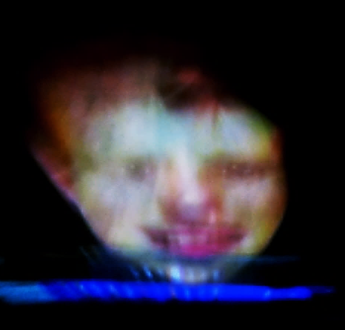

Slide 6
Case 2

Slide 7
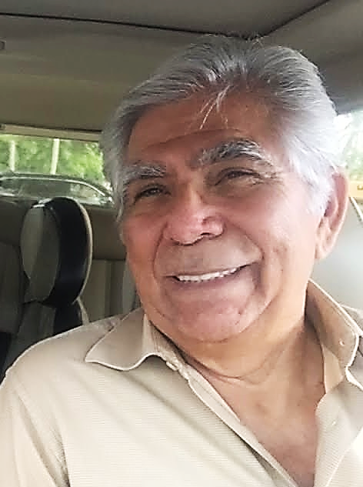
Daughter introduces Elio
My father, Elio Calzadilla, was brilliant mechanical engineer from Cuba. He was a jokester and lived to make my sister and I laugh. He passed of cancer four months after my daughter was born at the age of 80. Although he lived a full life, I feel he left too soon because I just had his first granddaughter, and I didn’t get a proper goodbye because of the pandemic. I miss him dearly.
I was shocked to see that my dad came out with his black hair and eyebrows. He indeed had thick jet-black hair and eyebrows when he was younger. His eyes are open wide in all of these images. In the photo I provided his eyes are squinting which is fascinating.
The double images are tricky to discern. The man on the right, my sister and I think it’s my uncle, Roberto Perez, who also passed from cancer back in 2015. That’s the man on the right side.
The younger face on the left, my mom thinks it’s my dad, but my sister and I don’t agree. I’ve attached a photo of my dad that looks like the face on the left but I feel my dad’s eyebrows were way bushier and have more of an arch. Still pretty compelling.
Elio Antonio Calzadilla of Miami, Florida, passed from cancer on December 10,
2020 at age 80.
Natalie

Slide 8
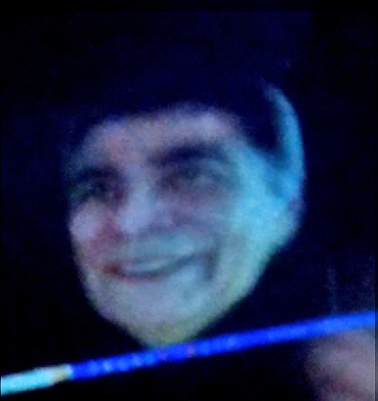
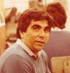
Impressive similarity

Slide 9
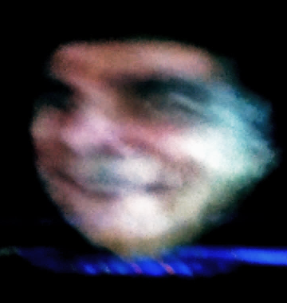

Slide 10
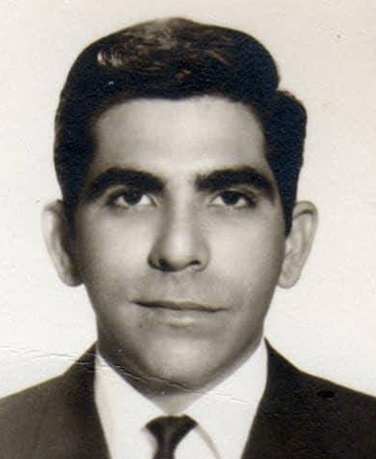

Impressive similarity

Slide 11
Case 3

Slide 12

Mom introduces Charlotte
From an early age, Charlotte lit up our lives with her beautiful smile, sparkling blue eyes and infectious laughter. She was a very loving, kind and generous daughter, sister and friend to all who loved her, especially adoring of her younger brother to whom she was very close. She was very curious and always learning throughout her life and shared this joy with us, which expanded our world and brought so much meaning and purpose to our lives. She loved the natural world, especially astronomy in her later years, and all animals, including a rescued horse which she patiently trained in dressage as a teenager. She was very intelligent and focused when pursuing her many academic interests and worked as an accountant and a lawyer, but while working as a professional she always found time to do volunteer work. When she decided to leave the corporate world and work as a free lance lawyer, she wrote a blog to encourage others that were self-employed and told me that if it helped just one person then it was worth it.
Charlotte Lauren of Arlington, Virginia, passed from unexplained/natural causes on December 19, 2021, at age 34. They were never able to determine exactly how she passed (had just gotten sick and passed).

Slide 13

Amazing
capacity
Using the photo below, inexplicably, lots of faces appeared beside the girl.
01.
This first “unknown” seems not to be a human.

Slide 14

This precision is inexplcable...
All we know is that they are not inside our Space-Time. Are they close? Are they in a Transmission Station? Where is it located? Is it in a different frequency and that is why we don´t see them?
This precision of placement of shaping the vapor indicates that They see us!
They know precisely where they have to mold the picture.
Can we say that they are “interfering” in our Side? Yes.
Via devices?
This is astonishing to say the least.
05.

Slide 15
Case 4

Slide 16
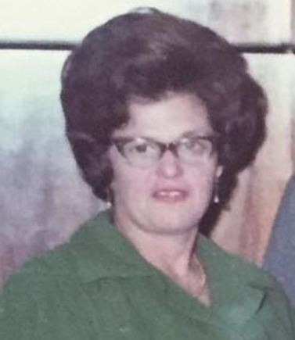
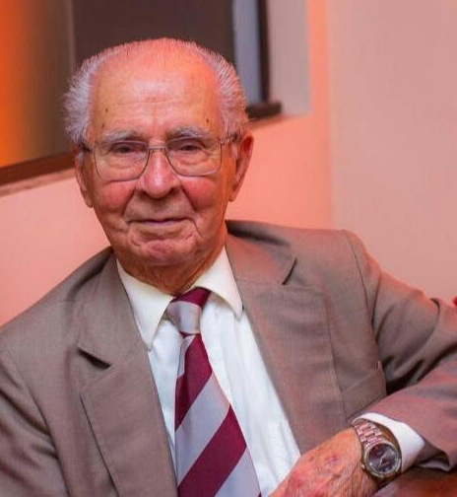
Case
Rosa & Honório
Honório Denardi , of Brazil, passed from pneumonia on December 8, 2022 at age 96.
Rosa Denardi also of Brazil, passed from lung cancer on December 26, 1991
(the day after Christmas) at age 67.

Slide 17

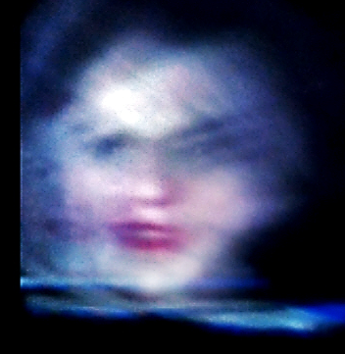
Rosa appears gorgeous
Rosa passed of cancer more than 20 years ago. She is fully renewed, happy and well. At left the very only photo sent by the daughter Ihina.

Slide 18

Rosa is in her 30ies
Not only in the Spiritist literature but in my research as well, we have seen hundred loved ones that die with a certain age but will appear younger and healthy.

